Slide 1

Project Title - SEASONAL AGRICULTURE PERFORMANCE ANALYSIS
NAME : Divya Kishor Sapkale
COLLAGE : Sandip Institute of Technology and Research Centre, Nashik
AICTE STU ID : STU6a673008799821785147400

Slide 2

PROBLEM STATEMENT
Seasonal Differences | Patterns & Trends | Resource Usage | Environmental Conditions | Economic Performance
Agricultural performance varies across seasons due to changes in environmental conditions, farming practices, resource availability, and market conditions.
However, raw agricultural data does not clearly reveal how performance changes between seasons or what meaningful patterns and relationships exist.
Therefore, this project analyzes the agricultural dataset to identify seasonal differences, trends, relationships, variations, and performance patterns to support evidence-based agricultural planning.

Slide 3
Project Description
Seasonal Agriculture Performance Analysis is a data analytics project that analyzes agricultural activities across different seasons, crops, and regions.
The project uses agricultural data containing:
🌾 Crop & Seasonal Information
🌦️ Environmental Conditions
💧 Resource & Water Usage
📊 Production & Yield
💰 Revenue, Cost & Profit
⚠️ Disease/Pest Risk
What the project does:
Data Cleaning
↓
Exploratory Analysis
↓
Seasonal Comparison
↓
Relationship Analysis
↓
Statistical Testing
↓
Insights & Recommendations

Slide 4

WHO ARE THE END USERS?
🌾 Farmers & Agricultural Managers Use seasonal performance insights for crop and resource planning.
🏛️ Agricultural Departments & Government Agencies Support evidence-based seasonal agricultural planning and policy decisions.
📊 Agricultural Analysts & Researchers Analyse seasonal trends, relationships, regional variations, and agricultural performance.
💧 Resource Management Teams Identify variations in water, fertilizer, pesticide, and other resource usage.
💼 Agribusiness & Market Stakeholders Understand seasonal production, revenue, cost, and profitability patterns.
Key Benefit: Data-driven insights → Better seasonal planning → Efficient resource utilization → Improved agricultural decision-making

Slide 5

Technology Used
💻 Programming & Development
Python
Google Colab
Jupyter Notebook
📊 Data Analysis
Pandas — Data manipulation & analysis
NumPy — Numerical computation
SciPy — Statistical analysis
📈 Data Visualization
Matplotlib — Data visualization
Seaborn — Statistical visualization
📁 Data & Output
CSV Dataset
Data Cleaning & Preprocessing
Statistical Analysis
Data Visualization

Slide 6
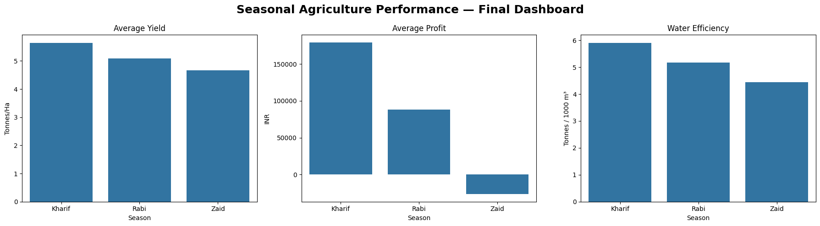
RESULTS - Overall Seasonal Performance
KEY RESULT
Kharif demonstrated the strongest overall seasonal performance, achieving the highest average yield, profit, and water efficiency.
⭐ Kharif → Highest Yield | Profit | Water Efficiency

Slide 7
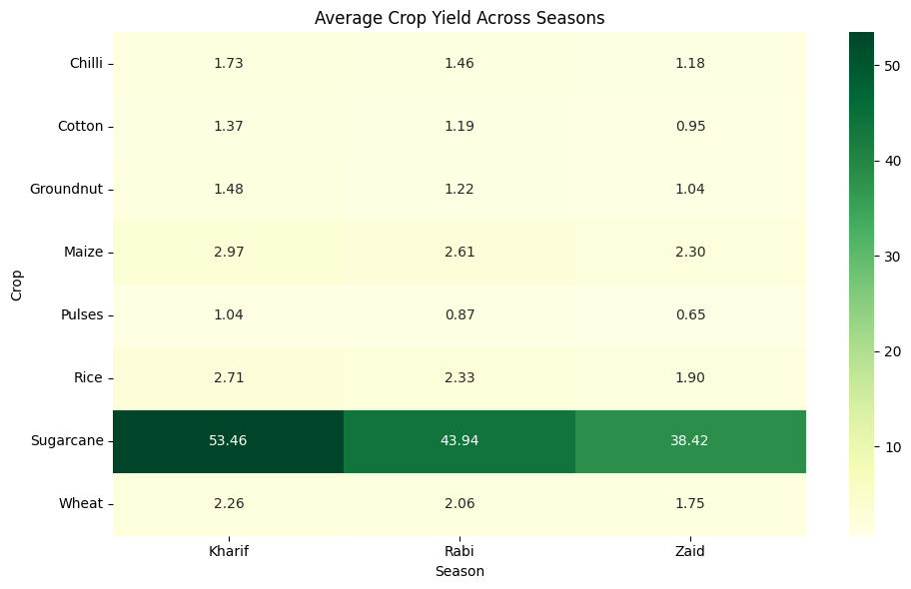
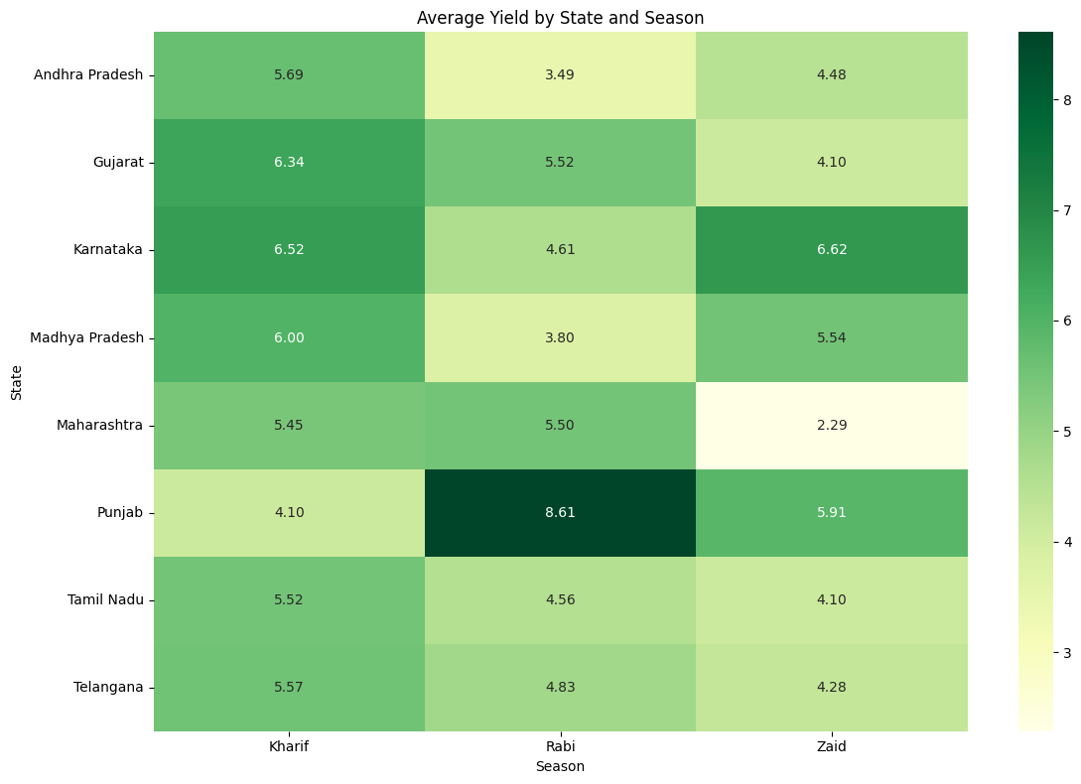
RESULTS - CROP & REGIONAL ANALYSIS
Fig. Crop × Season Yield Heatmap
Fig. State × Season Yield Heatmap
KEY FINDINGS
🌾 Sugarcane (Kharif) achieved the highest overall crop-season score.
📊 Crop performance varies across different seasons and regions.
🗺️ Regional analysis highlights differences in agricultural performance across states.

Slide 8
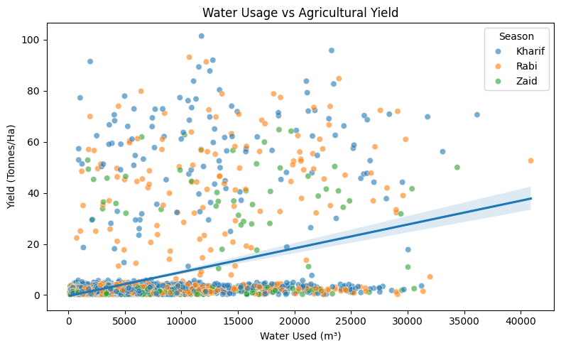
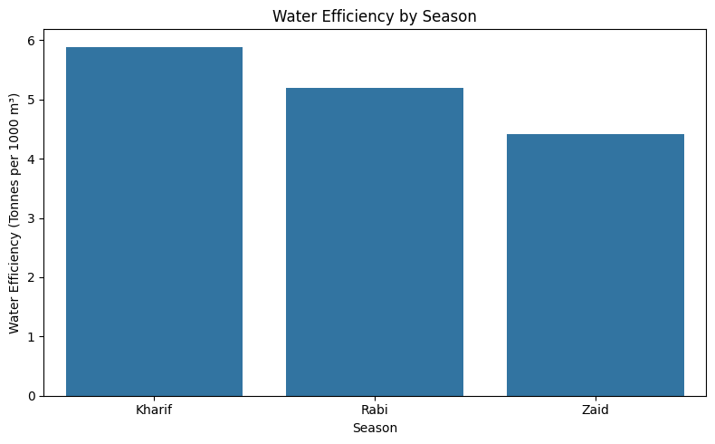
RESULTS — RESOURCE & WATER ANALYSIS
KEY FINDINGS
💧 Kharif showed the highest water 5.89 efficiency.
📈 Water usage had the strongest resource-level relationship with yield r ≈ 0.389.
🌱 Nitrogen and phosphorus showed statistically significant but very weak relationships with yield.
⚠️ Fertilizer and pesticide usage did not show significant linear relationships with yield.

Slide 9
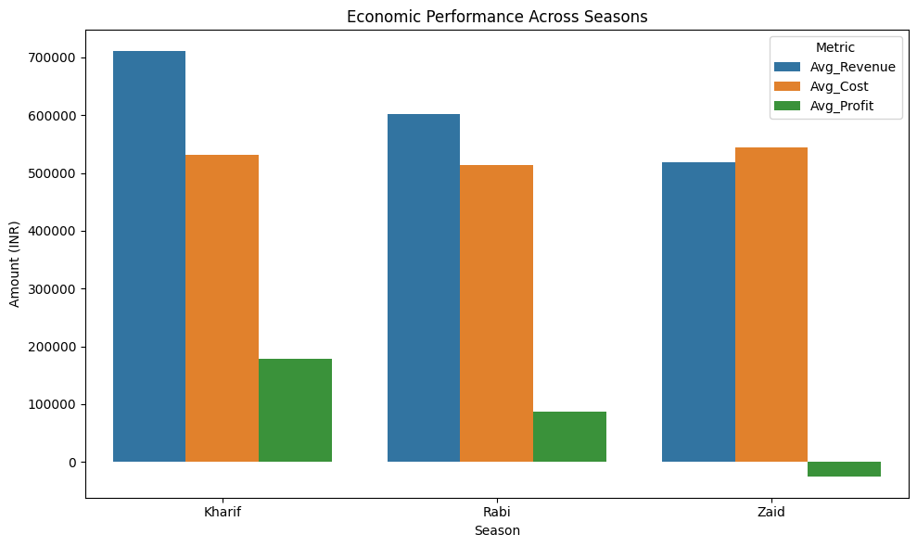
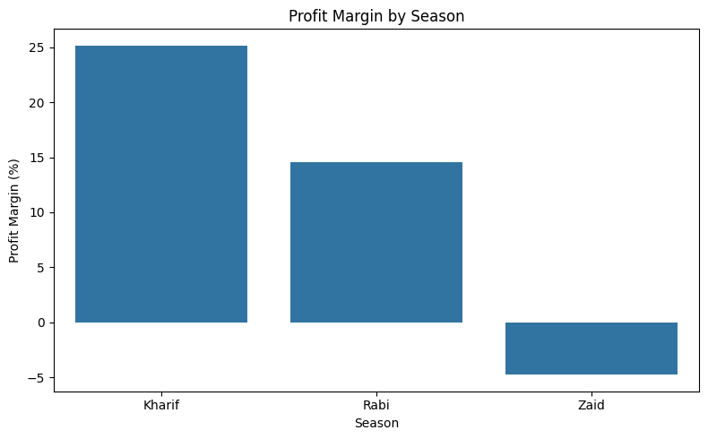
RESULTS — ECONOMIC PERFORMANCE
Fig. Revenue, Cost & Profit by Season
Fig. Crop × Season Profit Heatmap
KEY FINDINGS
💰 Kharif recorded the highest average profit: ₹179,367
📉 Zaid recorded negative average profit: −₹26,592
🌾 Profitability varies considerably across crops and seasons.
📊 Economic performance depends on the combined pattern of revenue and production costs.

Slide 10
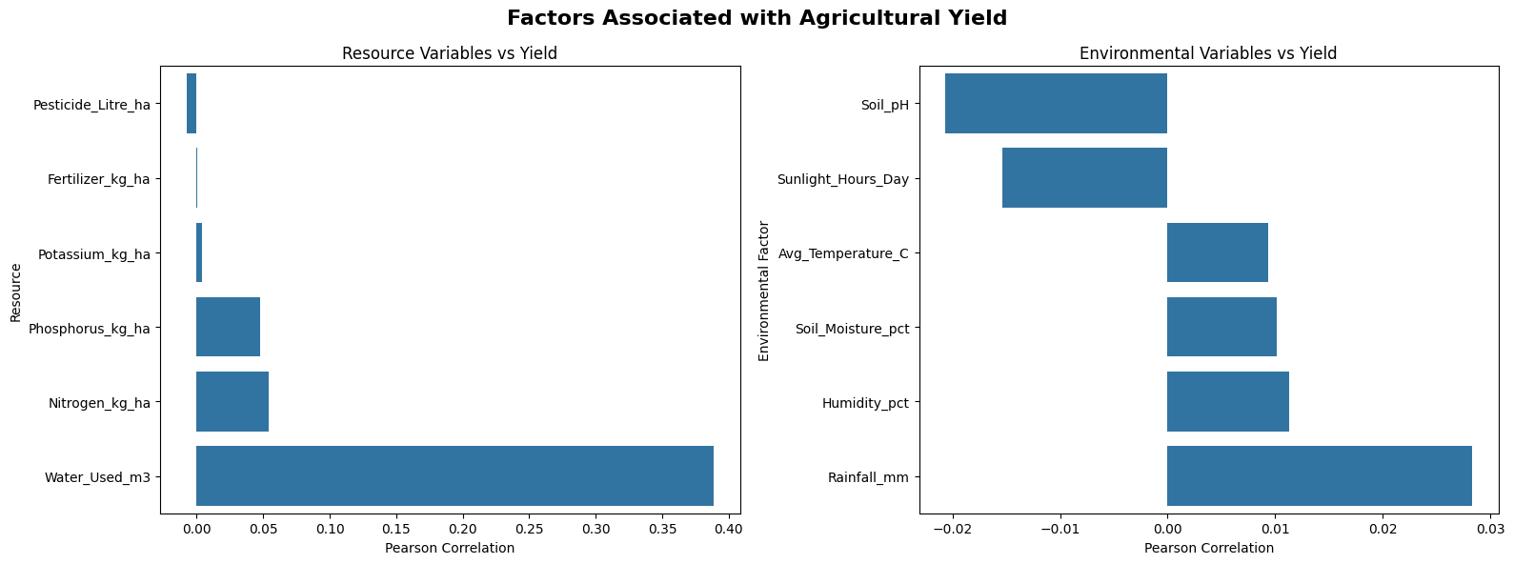
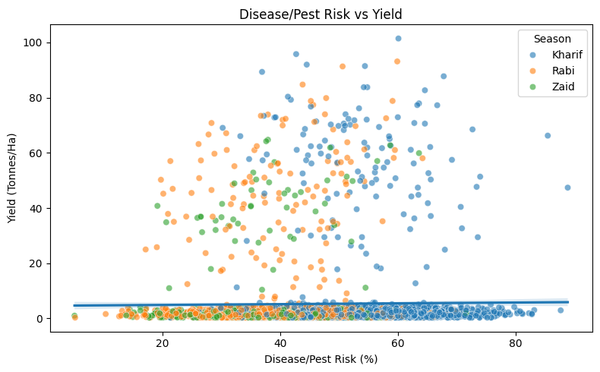
RESULTS Environmental & Risk Analysis
Key findings :ENVIRONMENTAL FINDINGS
🌧️ Rainfall → r = 0.028 🌡️ Temperature → r = 0.009 💧 Soil Moisture → r = 0.010 ☀️ Sunlight → r = −0.015 🌱 Soil pH → r = −0.021
Overall, the environmental variables showed weak linear relationships with yield in this dataset.
RISK FINDING :⚠️ Disease/Pest Risk vs Yield → r = 0.013, p = 0.396

Slide 11
RESULTS: Statistical Analysis
ANOVA RESULTS
Statistical Test | F-Statistic | p-value | Result
Seasonal Yield ANOVA | 1.458 | 0.233 | Not Significant
Seasonal Profit ANOVA | 34.598 | < 0.001 | Significant
Water Efficiency ANOVA | 6.948 | 0.001 | Significant
“The ANOVA results indicate statistically significant seasonal differences in profit and water efficiency.”
💧 WATER USED vs YIELD
r = 0.389 | p < 0.001
“Although Kharif had the highest average yield descriptively, the seasonal yield difference was not statistically significant.”
⭐ Profit & Water Efficiency → Significant
📊 Yield → Not Statistically Significant

Slide 12
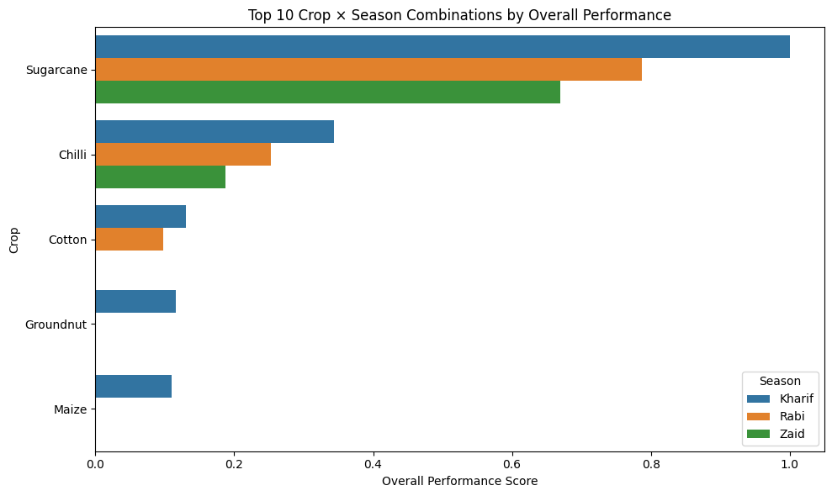
RESULTS: Overall Ranking & Key Findings
KEY FINDINGS
🥇 Kharif was the best-performing season overall.
🌾 Sugarcane (Kharif) achieved the highest overall crop-season score.
💰 Kharif recorded the highest average profit.
💧 Kharif achieved the highest water efficiency.
📊 Profit and water-efficiency differences across seasons were statistically significant.
⚠️ Seasonal yield differences were not statistically significant.
🥇 Best: Sugarcane — Kharif Overall Score: 1.000
📉 Lowest: Rice — Zaid Overall Score: 0.008

Slide 13
RECOMMENDATIONS
🌾 1. Focus on Seasonal Planning Use seasonal performance analysis to support crop selection and agricultural planning.
💧 2. Improve Water Management Monitor water usage and promote efficient irrigation practices, especially in lower-efficiency seasons.
📊 3. Optimize Resource Utilization Use data-driven analysis of fertilizers, nutrients, pesticides, and other inputs to improve resource planning.
💰 4. Improve Economic Planning Consider revenue, production cost, and profit together when evaluating crop-season combinations.
🗺️ 5. Use Regional Insights Consider differences between states/regions when planning agricultural activities.
⚠️ 6. Monitor Risk Factors Track disease/pest risk and unusual combinations such as high resource usage with low yield or high cost with low profit.
Data-driven seasonal analysis can support better crop selection, resource management, and agricultural planning.

Slide 14
Future scope
🤖 1. Machine Learning-Based Prediction Develop models to predict crop yield, profit, and seasonal performance using historical agricultural data.
🌦️ 2. Real-Time Weather Integration Integrate live rainfall, temperature, humidity, and other weather data for dynamic analysis.
🛰️ 3. Remote Sensing & Satellite Data Use satellite imagery and vegetation indices to monitor crop and regional conditions.
📍 4. Regional-Level Prediction Extend the system to provide location-specific crop performance and seasonal recommendations.
💧 5. Smart Resource Optimization Develop models to recommend efficient water, fertilizer, and pesticide usage.
📊 6. Interactive Analytics Dashboard Build an interactive dashboard using Power BI / Streamlit for real-time exploration of agricultural insights.
Future Vision: From historical analysis → predictive analytics → intelligent agricultural decision support

Slide 15
GitHub Link
Repository includes:
📓 Complete Jupyter/Google Colab Notebook
📊 Dataset
📈 Analysis results & exported files
📑 Project Presentation
📄 Project Documentation / README
GitHub Link :
https://github.com/divyaskrd/Seasonal-Agriculture-Performance-Analysis.git

Slide 16

VOIS Course completion certificate - Course name- Data Visualization

Slide 17
Thank you
Seasonal Agriculture Performance Analysis
Presented by Divya Kishor Sapkale
B.Tech Computer Engineering Sandip Institute of Technology and Research Centre, Nashik
.
.

